Slide 1
Motion Profiling for first tech challenge teams
By Joshua Heinrich, Mentor
Cruise Control #9889
September 25, 2020

Slide 2
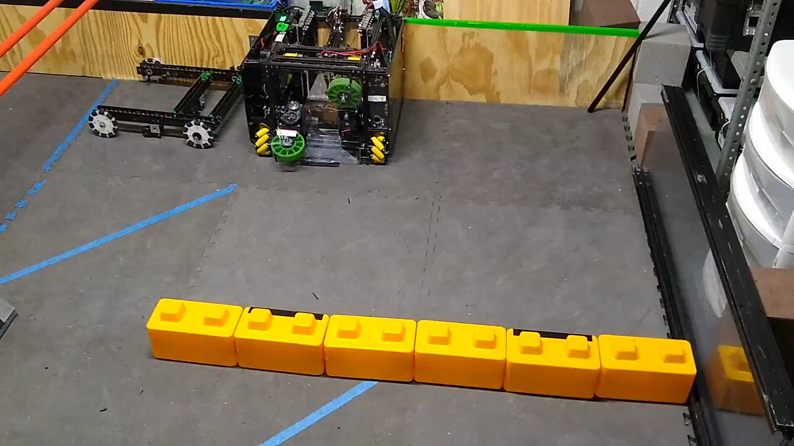
Why use motion profiling?

Slide 3
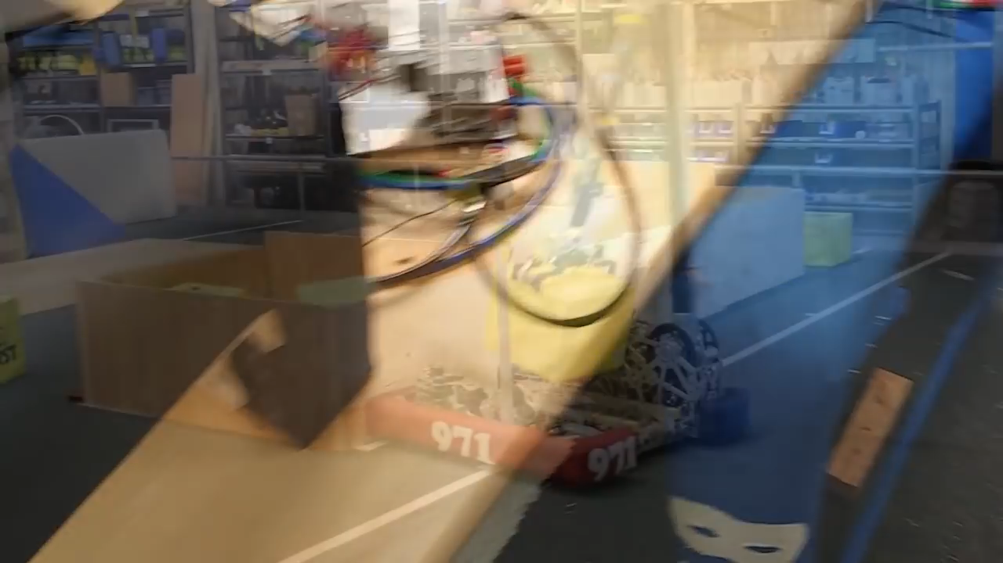
Why use motion profiling?

Slide 4
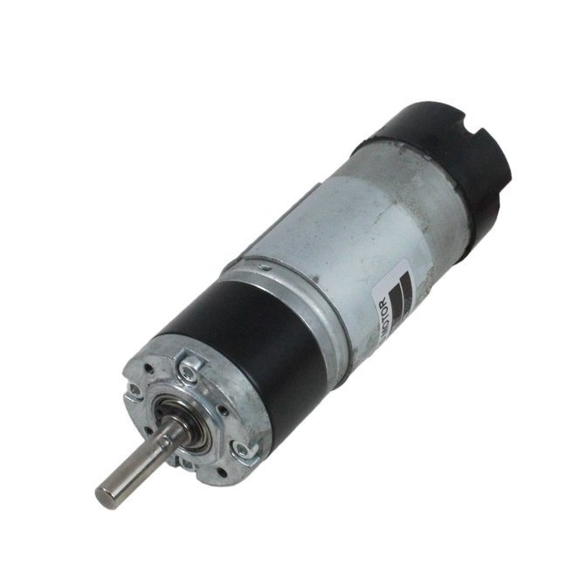
Why use motion profiling?
Repeatability and Redundancy
If encoders die, motion profiling will allow the robot to still be accurate
Less overshoot than other algorithms
For Points in Autonomous
Reaches the target/setpoint faster then other methods
Allow Driver to concentrate on other things
Synchronized motions (multi-axis arm, elevator)

Slide 5
Motion profiles
Start at zero velocity, Accelerate to a maximum velocity
Travel at constant velocity for most of the distance
Decelerate to a stop

Slide 6
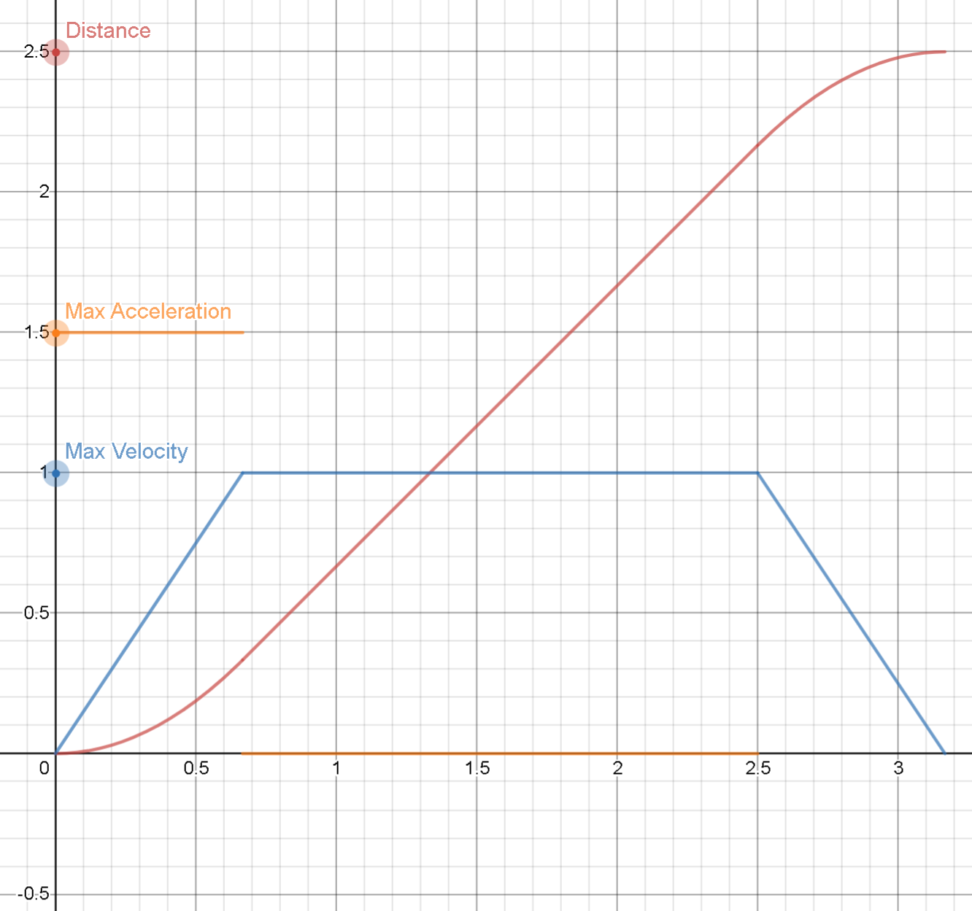
Generating a motion profile
Many different methods, we will cover continuous
A continuous motion profile calculates position, velocity, etc. for every possible time.
A discrete motion profile only calculates position, velocity, etc. for certain times.
We will be following these equations
https://www.desmos.com/calculator/ogjgtrgfka

Slide 7
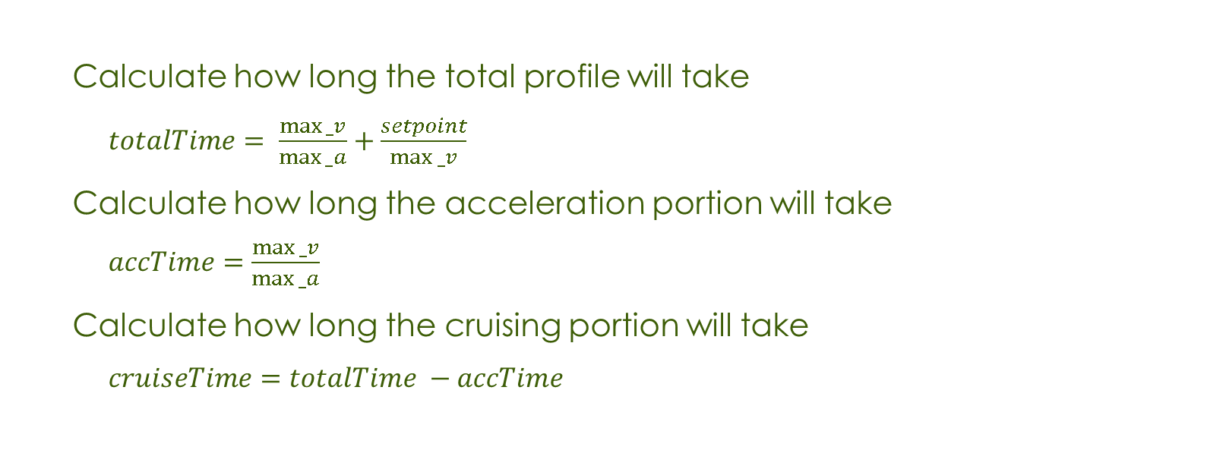
Generating a motion profile
Calculate how long the total profile will take
$totalTime= \frac{max⁡_v}{max⁡_a}+\frac{setpoint}{max⁡_v}$
Calculate how long the acceleration portion will take
$accTime=\frac{max⁡_v}{max⁡_a}$
Calculate how long the cruising portion will take
$cruiseTime=totalTime −accTime$

Slide 8
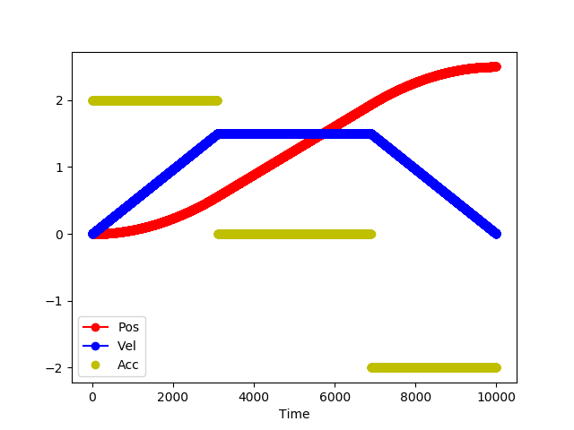
Generating a motion profile
if(t<= accTime)
Position = (0.5 * max_a) + (t * t)
Velocity = max_a * t
Acceleration = max_a
else if(t<=cruiseTime)
Position = (max_v * t) – ((max_v * max_v) / (2 * max_a))
Velocity = max_v
Acceleration = 0
else if(t<totalTime)
Position = (totalTime * max_v) + (totalTime * max_a * t) –
(max_v * max_v/max_a) – (
0.5 * ((max_a * t * t) + (max_a * totalTime * totalTime)))
Velocity = (max_a * totalTime) – (max_a * t)
Acceleration = -max_a

Slide 9
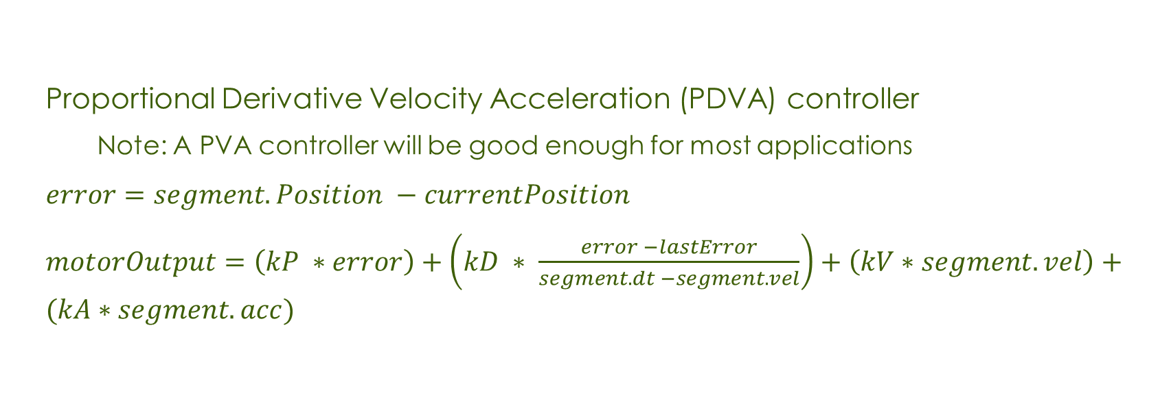
Following a motion profile
Proportional Derivative Velocity Acceleration (PDVA) controller
Note: A PVA controller will be good enough for most applications
$error=segment.Position −currentPosition$
$motorOutput=\left(kP ∗error\right)+\left(kD ∗ \frac{error −lastError}{segment.dt −segment.vel}\right)+\left(kV∗segment.vel\right)+(kA∗segment.acc)$

Slide 10
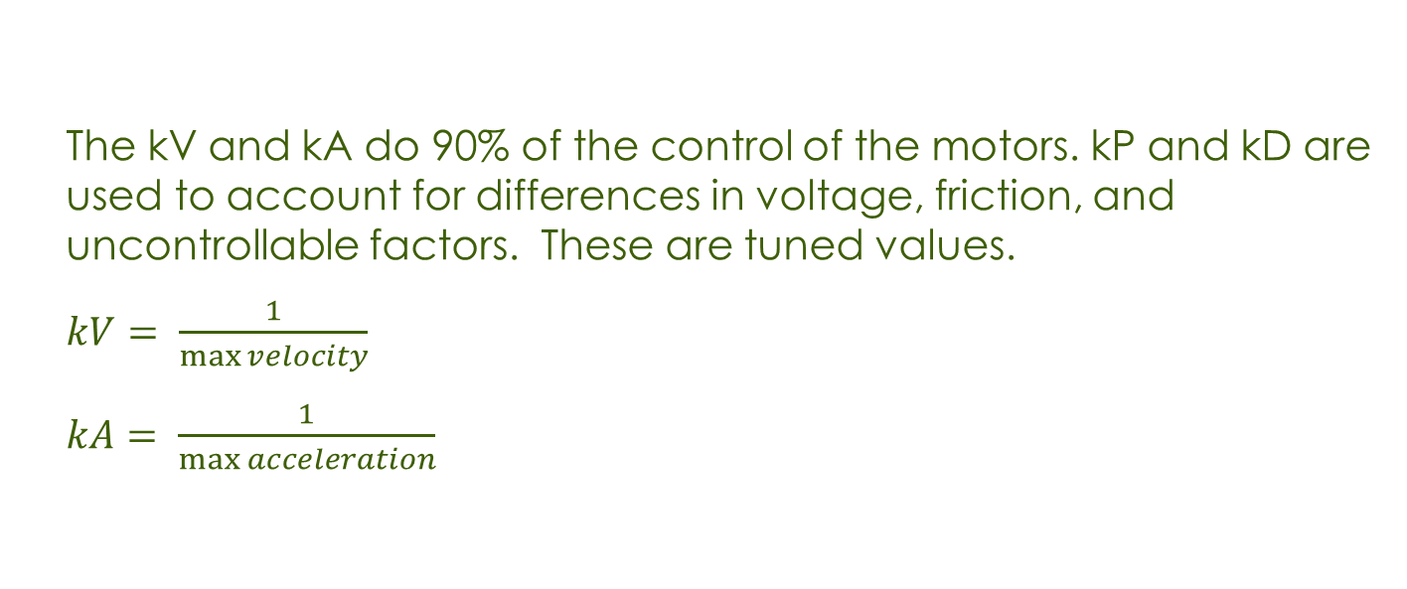
Following a motion profile
The kV and kA do 90% of the control of the motors. kP and kD are used to account for differences in voltage, friction, and uncontrollable factors. These are tuned values.
$kV= \frac{1}{\max{velocity}}$
$kA= \frac{1}{\max{acceleration}}$

Slide 11
Motion profiling in road runner
Road Runner
Developed by FTC Team 8367, Road Runner is a Kotlin library designed to path planning and following.
Has many built-in generators and followers
Does all the math for us!
Jerk Limited Profile! Can control how quickly the robot accelerates

